Slide 1
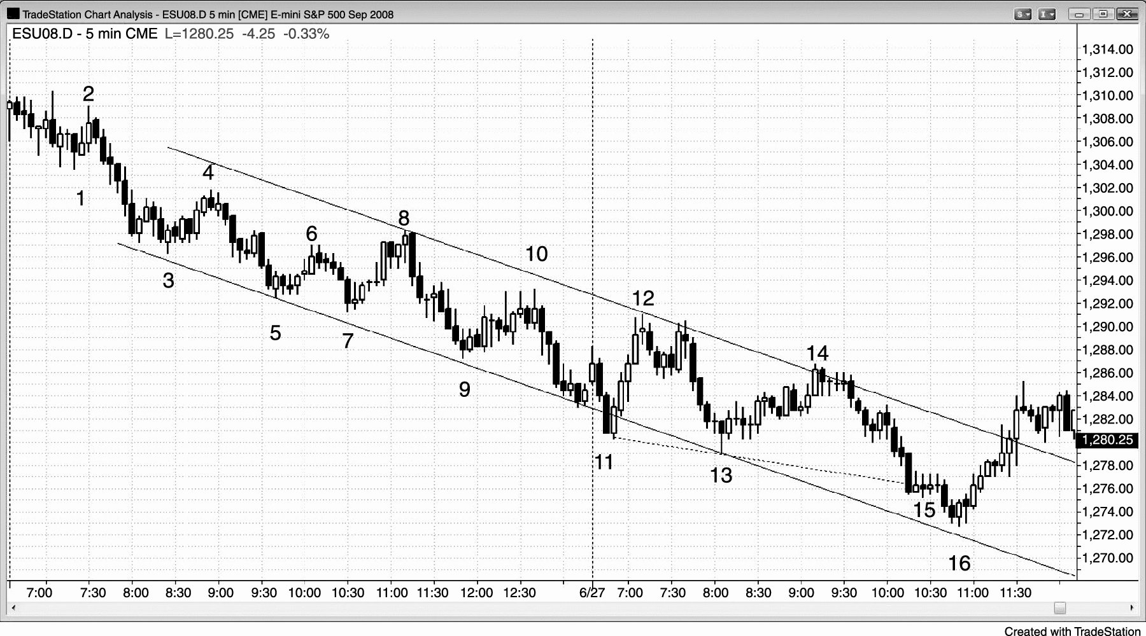
FIGURE 26.1 Bear Stairs

Slide 2
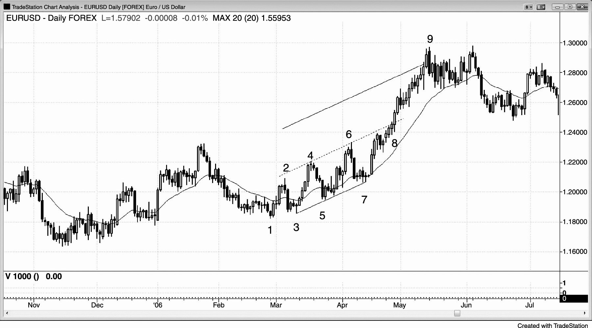
FIGURE 26.2 Stairs Accelerating into a Strong Trend

Slide 3
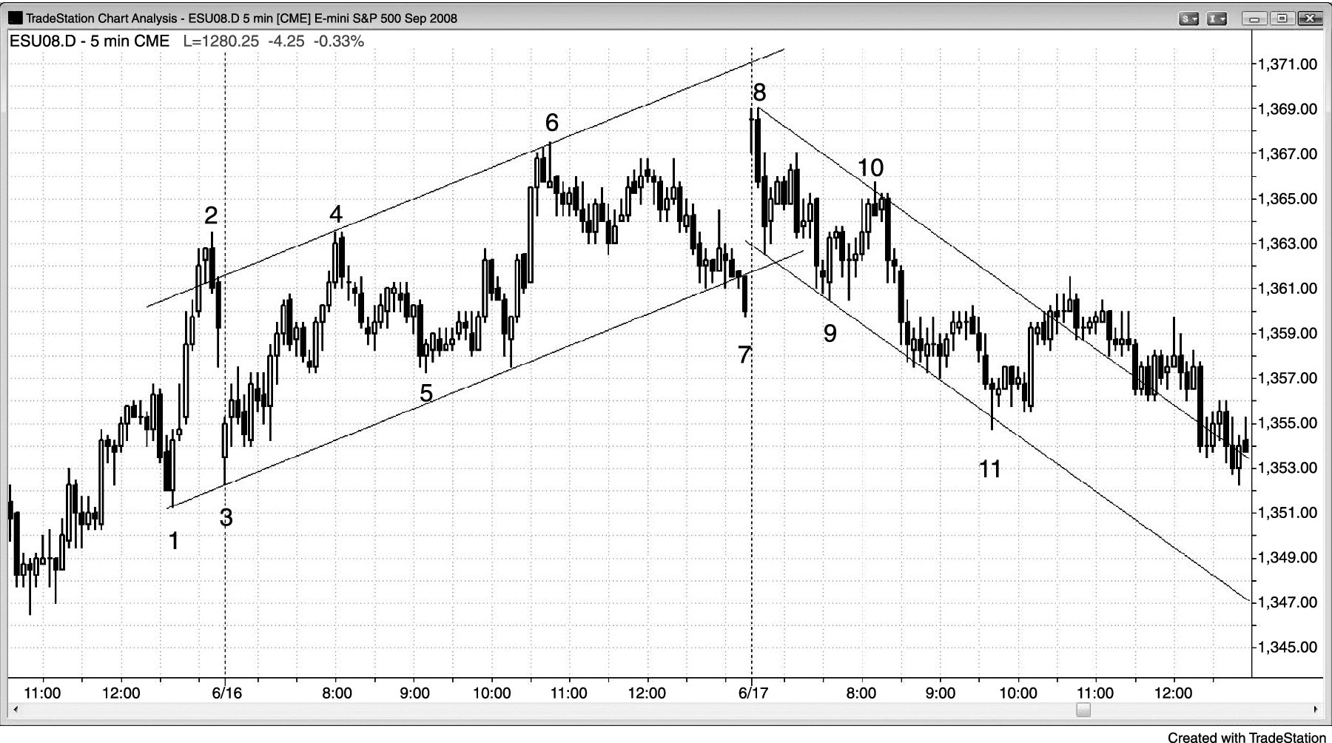
FIGURE 26.3 Shrinking Stairs

